Slide 1
CROP RECOMMENDER SYSTEM USING MACHINE LEARNING APPROACH

Slide 2
ABSTRACT
This paper proposes a viable and user-friendly yield prediction system for the farmers. The proposed system provides connectivity to farmers. The user provides the area & soil type as input. Machine learning algorithms allow choosing the most profitable crop list or predicting the crop yield for a user-selected crop. To predict the crop yield, selected Machine Learning algorithm is used.

Slide 3
EXISTING SYSTEM
Extensive work has been done, and many ML algorithms have been applied in the agriculture sector. The biggest challenge in agriculture is to increase farm production and offer it to the end-user with the best possible price and quality. It is also observed that at least 50% of the farm produce gets wasted, and it never reaches the end-user. The proposed model suggests the methods for minimizing farm produce wastage. In this model where the crop yield is predicted using KNN algorithms by making the clusters. It has been shown that KNN clustering proved much better than SVM or regression.

Slide 4
DISADVANTAGES OF EXISTING SYSTEM
The main challenge faced in agriculture sector is the lack of knowledge about the changing variations in climate. Each crop has its own suitable climatic features. This can be handled with the help of precise farming techniques. The precision farming not only maintains the productivity of crops but also increases the yield rate of production.

Slide 5
The existing system which recommends crop yield is either hardware-based being costly to maintain, or not easily accessible.
Despite many solutions that have been recently proposed, there are still open challenges in creating a user-friendly application with respect to crop recommendation.

Slide 6
PROPOSED SYSTEM
In this project, we have proposed a model that addresses the existing issues. The novelty of the proposed system is to guide the farmers to maximize the crop yield as well as suggest the most profitable crop for the specific region.
The proposed model provides crop selection based on economic and environmental conditions, and benefit to maximize the crop yield that will subsequently help to meet the increasing demand for the country's food supplies. The proposed model predicts the crop yield by studying factors such as rainfall, temperature, area, season, soil type etc. The system also helps to determine the best time to use fertilizers.

Slide 7
The user provides an area under cultivation and soil type as inputs. According to the requirement, the model predicts the crop yield for a specific crop. The model also recommends the most profitable crop and suggests the right time to use the fertilizers.
The main objective is to obtain a better variety of crops that can be grown over the season. The proposed system would help to minimize the difficulties faced by farmers in choosing a crop and maximize the yield.

Slide 8
ADVANTAGES OF PROPOSED SYSTEM
The proposed model predicts the crop yield for the data sets of the given region. Integrating agriculture and ML will contribute to more enhancements in the agriculture sector by increasing the yields and optimizing the resources involved. The data from previous years are the key elements in forecasting current performance.
The proposed system uses recommender system to suggest the right time for using fertilizers.

Slide 9
The methods in the proposed system includes increasing the yield of crops, real-time analysis of crops, selecting efficient parameters, making smarter decisions and getting better yield.

Slide 10
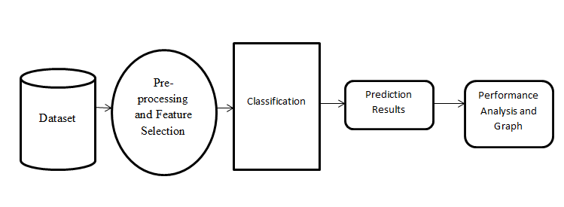
SYSTEM ARCHITECTURE

Slide 11
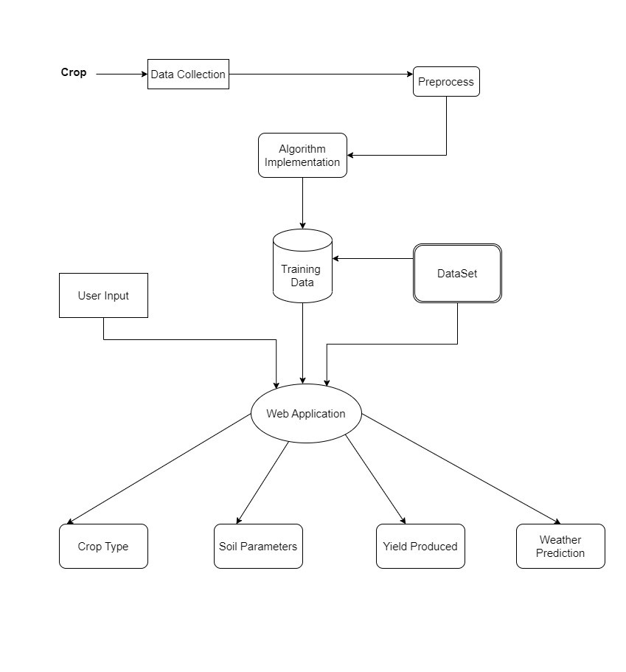

Slide 12
HARDWARE REQUIREMENTS
System : Pentium i3 Processor.
Hard Disk : 500 GB.
Monitor : 15’’ LED
Input Devices : Keyboard, Mouse
Ram : 4 GB

Slide 13
SOFTWARE REQUIREMENTS
Operating system : Windows 10.
Coding Language : Python
Web Framework : Flask

Slide 14
REFERENCE
SHILPA MANGESH PANDE, DR. PREM KUMAR RAMESH, ANMOL, B.R AISHWARYA, KARUNA ROHILLA, KUMAR SHAURYA, “Crop Recommender System Using Machine Learning Approach”, IEEE Conference 2021.

Slide 15
Thank You

